Slide 1

Adoption and Evaluation of Explainable Artificial Intelligence Techniques in Occupational Health and Safety for the Prevention of Musculoskeletal Symptoms
Matthew Nnadozie
MSc Data Science
June 2023

Slide 2
Content
ELEMENT ONE
Background
ELEMENT two
Limitation
ELEMENT three
Research Objectives & Scope
ELEMENT four
Research Approach
ELEMENT five
Methodology
.
ELEMENT six
Result and Conclusion

Slide 3

Background
Increase adoption and application of AI across all fields
The reasoning underlying black box models remains ambiguous
The legal requirement to provide explanation to users of AI
Evaluation
Application & Adoption
Interpretability
Regulation
Requirement for standardized metrics for XAIs
Application and adoption of AI-enabled systems
Increase in model complexity and challenge of understanding the reasoning behind model predictions
Demand for explanation and interpretation of AI models
General Data Protection Regulation (GDPR) requires that meaningful information be provided for decisions from automated systems
Need to resolve the issue of trust in the use of AI
Need to measure the performance of XAI using standardized metrics
4
5
1
3
2

Slide 4

limitations
Inadequacy of an assessment framework for evaluating the efficacy of XAI
Absence of consensus among researchers regarding the terminology and explicatory characteristics XAI
Limited comprehension of model predictions and their interpretability

Slide 5


Research objectives
To identify the best-performing XAI for adoption in occupational health and safety for the prevention of musculoskeletal symptoms and disorders
To help create trust and acceptance in the use of artificial intelligence across all sensitive fields

Slide 6
RESEARCH APPROACH
Action Planning
Evaluation
Model Analysis
Evaluate model performance
Evaluate XAI performance
Project execution
Data collection
Data approval
Define approach and scope
Problem Identification
Implementation
Findings
Model building
Data analysis
Identify algorithms
Implement models
Discuss findings
Benefits
Limitations
Conclusion
Research topic
Literature review
Gap identification

Slide 7
Methodology
BLACKBOX MODELS
(DT, RF, SVM, LGBM, XGBoost, CatBoost, GradBoost, ANN)
DATA
PREDICTIONS
SHAP
GLOBAL
ASV
EXPLANATIONS
LOCAL
PI
LIME

Slide 8
RESULT

Slide 9
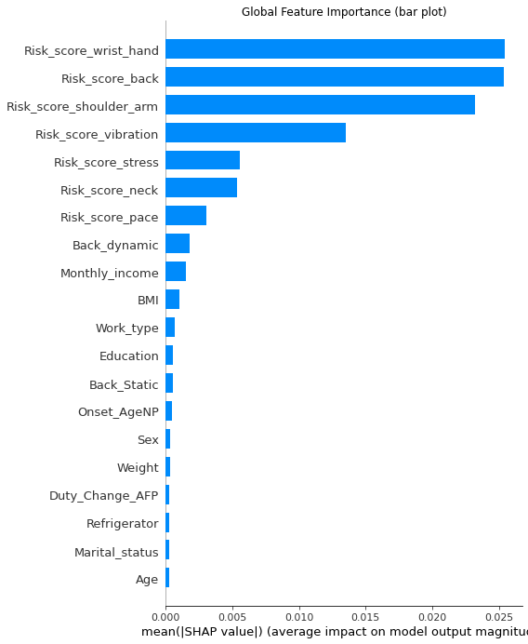
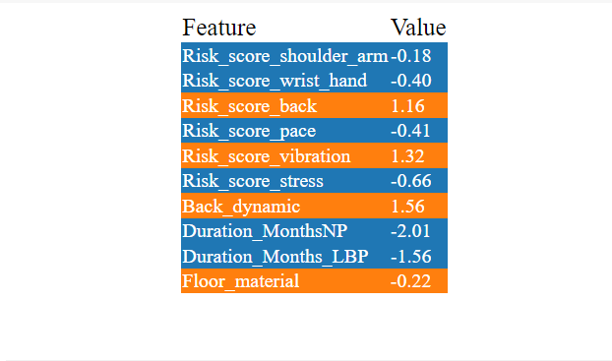
EXPLANATIONS
SHAP
PI
LIME

Slide 10
result
Evaluation of Explainable AI Models
Understandability
Interpretability
Fidelity
TOTALS
SHAP
PI
LIME
ASV
Understandability | Measures how well the user can discern the workings of the model after the explanation
Interpretability | Measures how unambiguous the explanation presented by the XAI is to humans.
Fidelity | Measures how well the explanations provided by the XAI model replicate the actual decision-making process of the model
MAE | Measures the average magnitude of the errors in a set of predictions, without considering their direction

Slide 11
CONCLUSION
ENHANCEMENT
TRUST
Explainable AI can greatly enhance the prevention of WMSD
Explainable AI allows OHS professionals to understand and develop trust in the decision-making process of models
COMPLIANCE
Explainable AI promotes compliance with ethical and legal requirements by detecting and eliminating biases and audit search
measurement
TRAINING
Lack of standardized quantifiable measures for evaluating explainable AIs
Adoption and application of XAI in OHS may require some level of expertise

Slide 12


